Slide 1

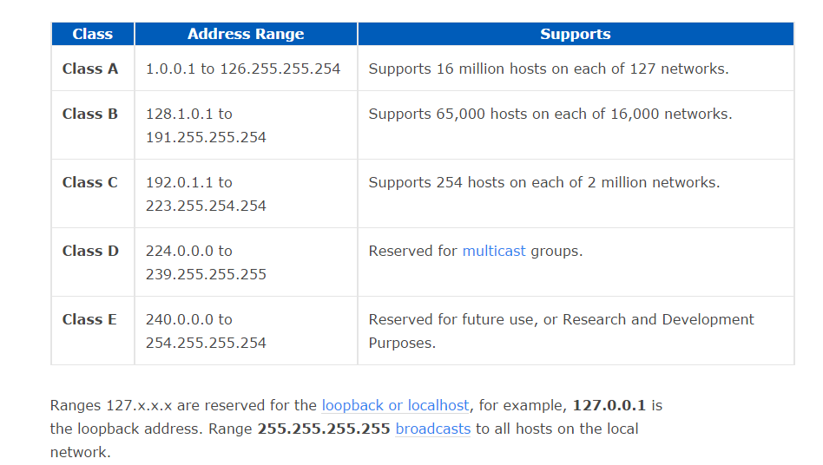

Slide 2
PRIVATE IP RANGES
CLASS A: 10.0.0.0 to 10.255.255.255
CLASS B: 172.16.0.0 to 172.31.255.255
CLASS C: 192.168.0.0 to 192.168.255.255

Slide 3
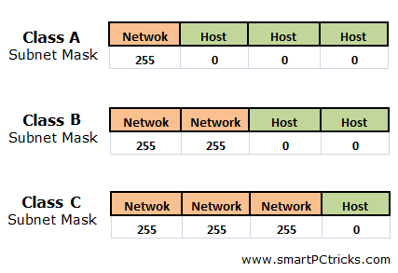

Slide 4
A gateway is a node (router) in a computer network, a key stopping point for data on its way to or from other networks. Thanks to gateways, we are able to communicate and send data back and forth. The Internet wouldn't be any use to us without gateways

Slide 5
Network Address Translation (NAT) is the process where a network device, usually a firewall, assigns a public address to a computer (or group of computers) inside a private network. The main use of NAT is to limit the number of public IP addresses an organization or company must use, for both economy and security purposes.

Slide 6
